Slide 1

Lecture
on
“Advanced Computer Architecture –TCS 704”
by
Akansha Gupta
DEPARTMENT OF COMPUTER SCIENCE AND ENGINEERING
GRAPHIC ERA DEEMED TO BE UNIVERSITY – 248002

Slide 2
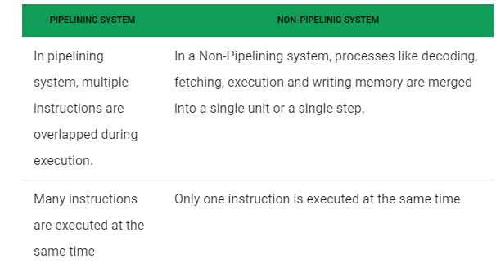
Difference between Pipelining and Non-Pipelining

Slide 3
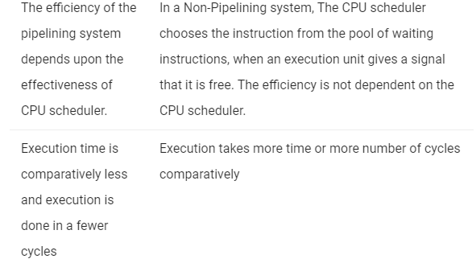

Slide 4
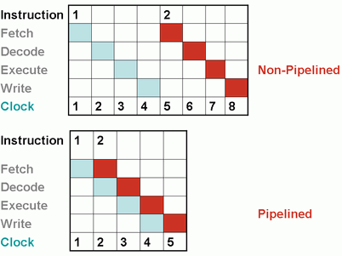

Slide 5
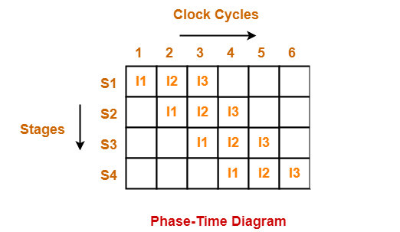
Phase-Time Diagram
Phase-time diagram shows the execution of instructions in the pipelined architecture.
The following diagram shows the execution of three instructions in four stage pipeline architecture.

Slide 6
Time taken to execute three instructions in four stage pipelined architecture = 6 clock cycles.
NOTE
In non-pipelined architecture,
Time taken to execute three instructions would be
= 3 x Time taken to execute one instruction
= 3 x 4 clock cycles
= 12 clock cycles

Slide 7
Pipelined Architecture
In pipelined architecture,
The hardware of the CPU is split up into several functional units.
Each functional unit performs a dedicated task.
The number of functional units may vary from processor to processor.
These functional units are called as stages of the pipeline.
Control unit manages all the stages using control signals.
There is a register associated with each stage that holds the data.
There is a global clock that synchronizes the working of all the stages.
At the beginning of each clock cycle, each stage takes the input from its register.
Each stage then processes the data and feed its output to the register of the next stage.

Slide 8
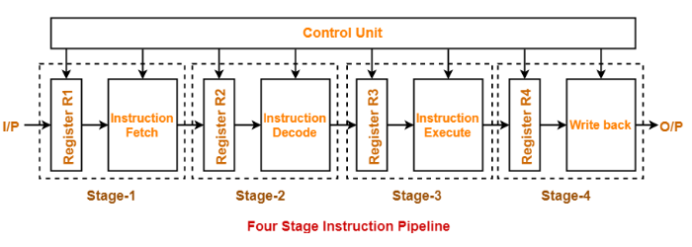

Slide 9
Types of Pipeline
It is divided into 2 categories:
Arithmetic Pipeline
Instruction Pipeline

Slide 10
Arithmetic Pipeline
Arithmetic pipelines are usually found in most of the computers. They are used for floating point operations, multiplication of fixed point numbers etc. For example: The input to the Floating Point Adder pipeline is:
X = A*2^a
Y = B*2^b
Here A and B are mantissas (significant digit of floating point numbers), while a and b are exponents.

Slide 11
Instruction Pipeline
In this a stream of instructions can be executed by overlapping fetch, decode and execute phases of an instruction cycle. This type of technique is used to increase the throughput of the computer system.
An instruction pipeline reads instruction from the memory while previous instructions are being executed in other segments of the pipeline. Thus we can execute multiple instructions simultaneously. The pipeline will be more efficient if the instruction cycle is divided into segments of equal duration

Slide 12
Advantages of Pipelining
Instruction throughput increases.
Increase in the number of pipeline stages increases the number of instructions executed simultaneously.
Faster ALU can be designed when pipelining is used.
Pipelined CPU’s works at higher clock frequencies than the RAM.
Pipelining increases the overall performance of the CPU.

Slide 13
Disadvantages of Pipelining
Designing of the pipelined processor is complex.
Instruction latency increases in pipelined processors.
The throughput of a pipelined processor is difficult to predict.
The longer the pipeline, worse the problem of hazard for branch instructions.

Slide 14
https://youtu.be/-wcVXAl53Tk
THANKS

